Slide 1
Pin Align Graphical User Interface
By: Samuel Clark
Supervisor: Edwin Lazo

Slide 2
Project Scope
Create a Graphical User Interface (GUI) for the pin align program that will allow users to automatically configure the program to their beamline.
Requirements for auto configuration:
Centered Image OR X & Y point to center
Rod Length
Pixel per MM
X, Y, Z Direction

Slide 3
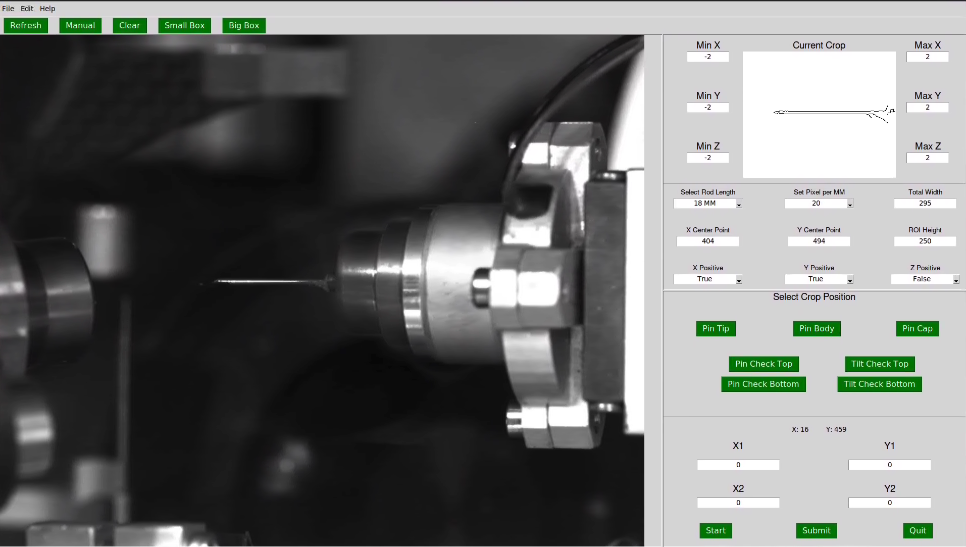
Break Down of the GUI

Slide 4
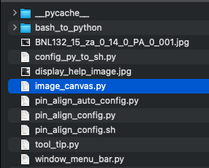
Image Canvas

Slide 5
Image Canvas

Slide 6
Image Canvas
Contains a lot of the main functionality for the program.
Most of the code for the functionality of the image side of the GUI is kept in image_canvas.py
Defined as image_in_canvas in pin_align_auto_config.py

Slide 7
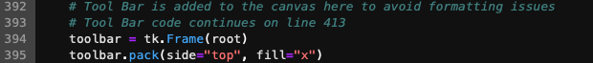
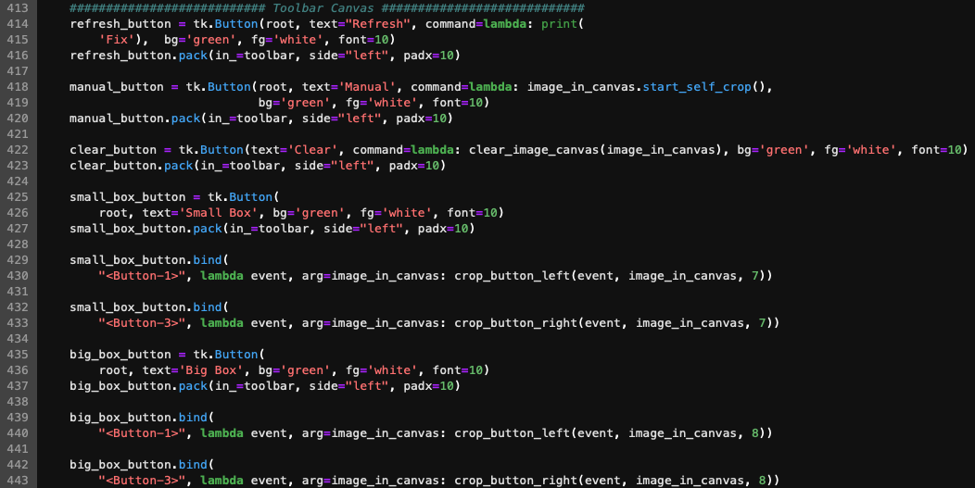
Tool bar Canvas

Slide 8
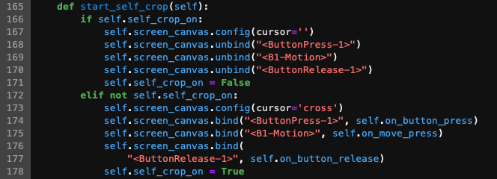
Tool Bar Canvas: Manual Button

Slide 9
Tool Bar Canvas: Manual Button
Not useful in current program
Functionality currently only allows user to draw a rectangle on the image
To do:
Manual button should allow the user to change the ROI’s instead of drawing them

Slide 10
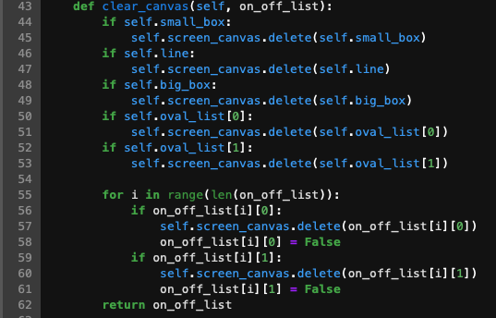
Tool Bar Canvas: Clear Button

Slide 11
Tool Bar Canvas: Clear Button
To do:
Currently does not clear a manually drawn rectangle.

Slide 12
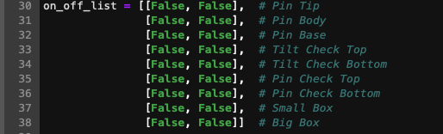
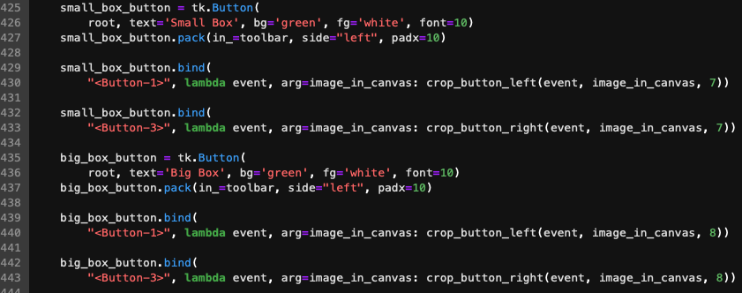
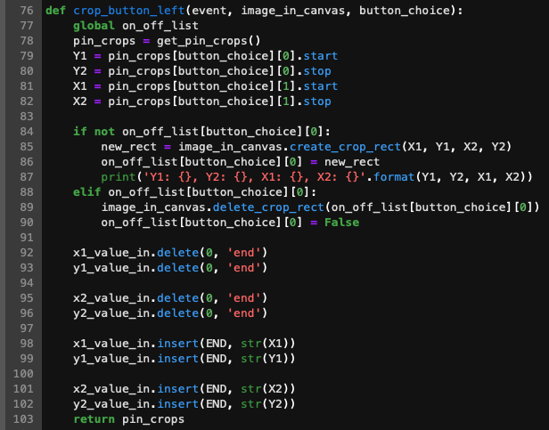
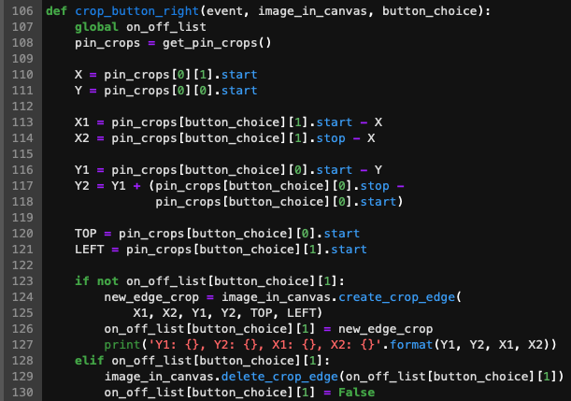
Tool Bar Canvas: Small Box & Big Box

Slide 13
Tool Bar Canvas: Small Box & Big Box
Big Box – This is the main crop of the image and is used to generate the pin tip, pin body, and pin base ROIs.
Small Box– This ROI should contain the tip of the pin. If the tip of the pin is not inside the Small Box, the user should use the reconfigure tool.
User can left click for outline of the corresponding button or right click for an edge detected overlay

Slide 14
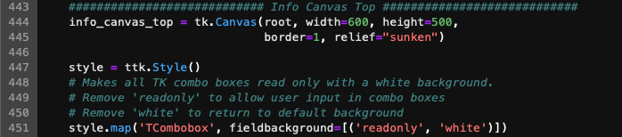
Info Canvas top
Users can edit all settings in the Info Canvas Top
Shows Edge Detected ROI from current config on the input image

Slide 15
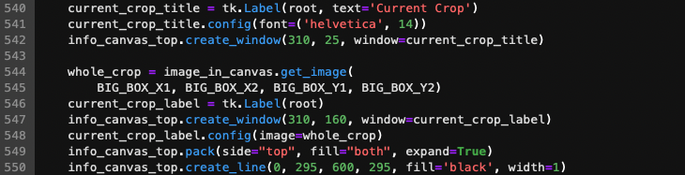
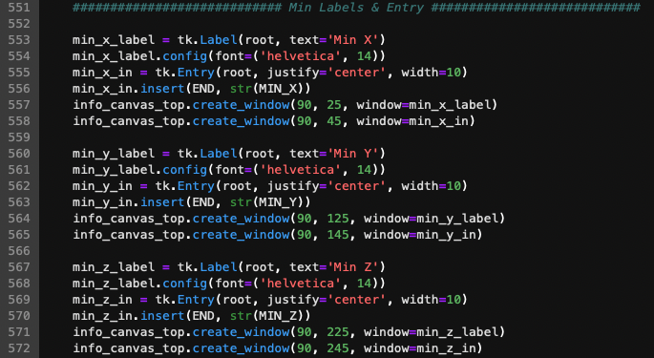

Info Canvas top

Slide 16
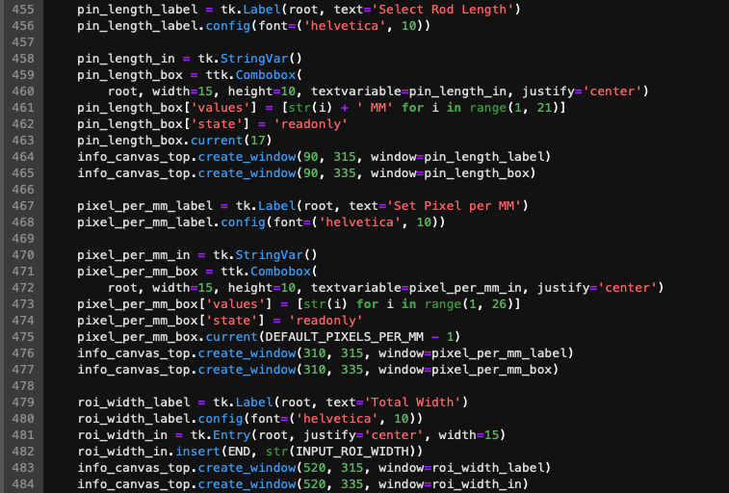
Info Canvas top

Slide 17
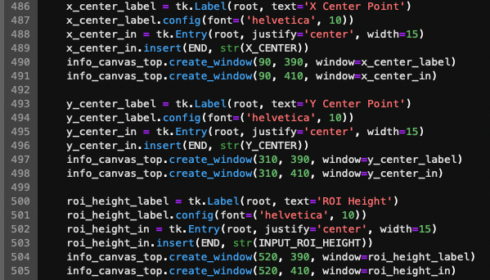
Info Canvas top

Slide 18
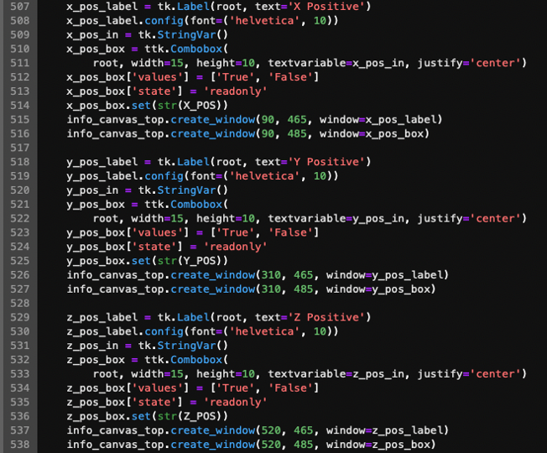
Info Canvas top

Slide 19
Info Canvas Top
Users can run the automatic configuration by entering their X and/or Y Point to Center values and hitting submit. This will show the new Bix Box & Small Box ROIs.
Changing the value of any of the other boxes in the Info Canvas Top and hitting submit will also update the configuration file.
The user should enter the X, Y, & Z positive directions appropriate for their beamline.

Slide 20
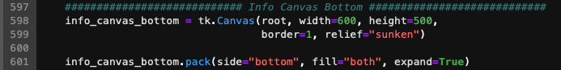
Info Canvas Bottom

Slide 21
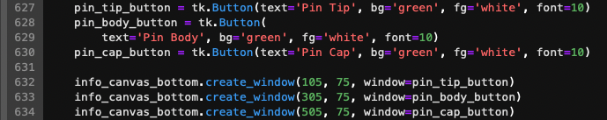
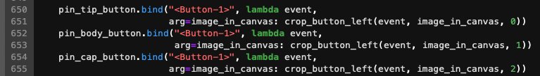
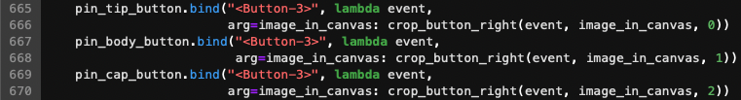
Info Canvas Bottom: Main ROI Buttons

Slide 22
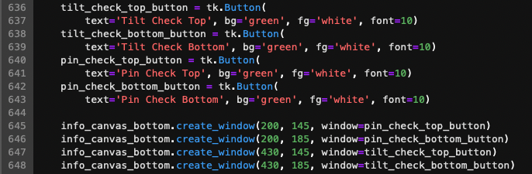
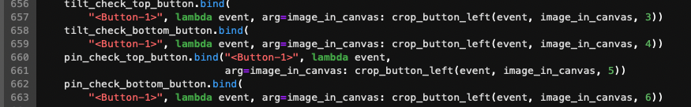
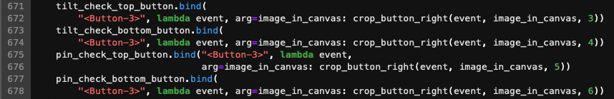
Info Canvas Bottom: Pin & Tilt Check Buttons

Slide 23
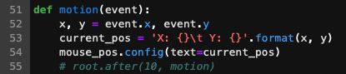
Info Canvas Bottom: Mouse Tracking

Slide 24
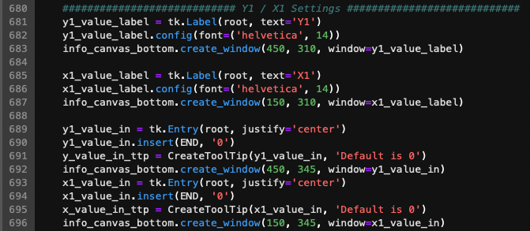
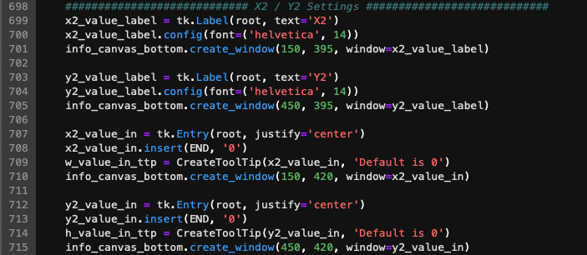
Info Canvas Bottom: ROI X & Y Values

Slide 25
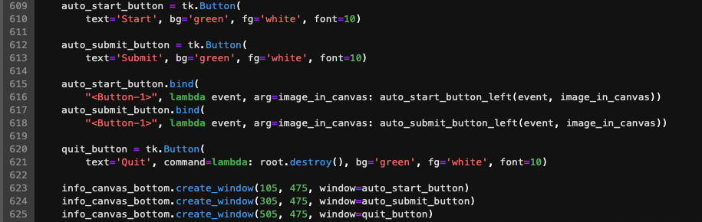
Info Canvas Bottom: ROI X & Y Values

Slide 26
Info Canvas Bottom

Slide 27
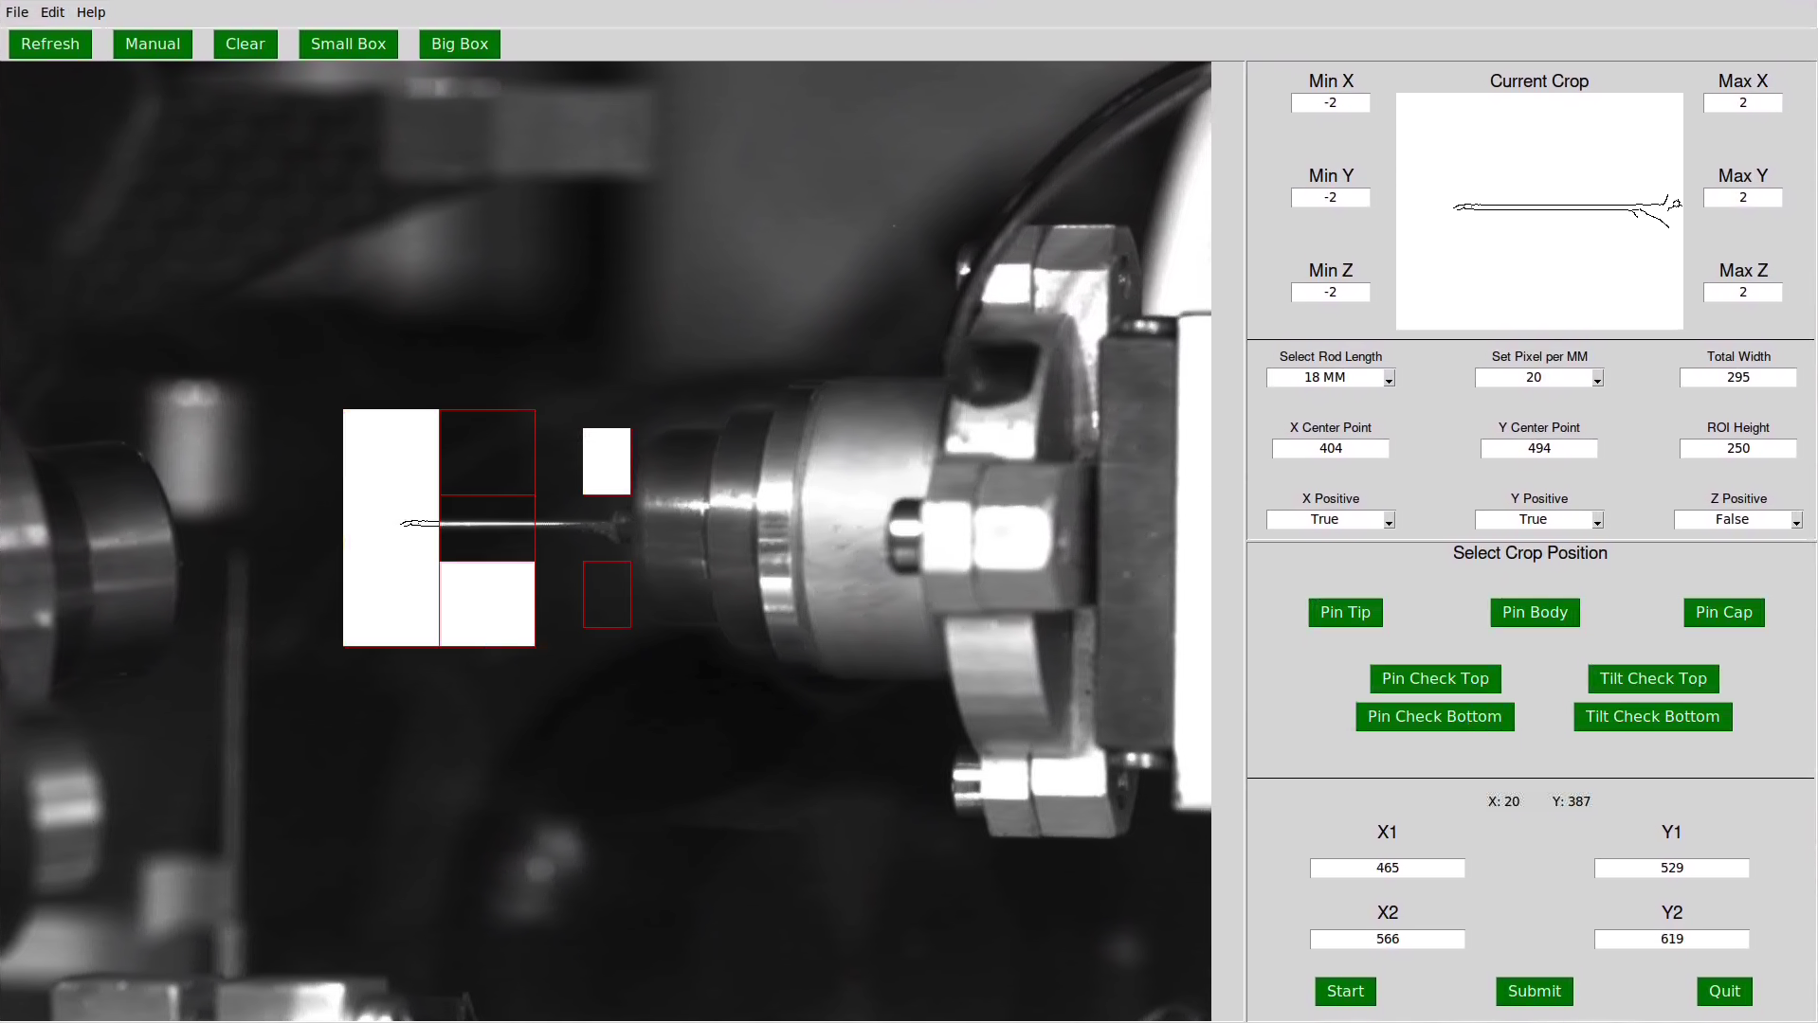
Showing ROI
Shows Edge ROI
Shows Outline of ROI
Right Click
Left Click

Slide 28
Using the GUI

Slide 29
AMX Auto Configuration

Slide 30
AMX Auto Config

Slide 31
Problems
ls: cannot access 'CENTRAL': Stale file handle
Possibly lost access to CENTRAL
Can not get access to centered image
Need most up-to-date AMX & FMX config files

